Slide 1
OZYMANDIAS -P.B. SHELLEY
Prepared by,
B.Rashma M.A., NET
Assistant Professor of English
Jamal Mohamed College

Slide 2
INTRODUCTION:
P.B. Shelley(1792-1822)
Percy Bysshe Shelley is one of the major English Romantic poets.
Greatest lyrical and philosophical poets and one of the highly regarded and influential poets of the 19th cent..
Born: 4th August 1792, Horsham, United Kingdom(UK)
Literary Movement: Romanticism
Occupation: Poet, dramatist, essayist and novelist
Notes:
(Bish)

Slide 3
CHILDHOOD AND EDUCATION
He was the first of seven children born to Elizabeth pilfold Shelley and sir Timothy Shelley. (Whig parliamentarian)
In 1804, he attended Eton college, the boys’ boarding school.
In 1810, he entered the university of Oxford - unsuccessful college career.
Shelley and his friend Thomas Hogg had co-authored a pamphlet titled The Necessity of Atheism.
The university expelled them from the college because Shelley refused to deny authorship of a pamphlet called The Necessity of Atheism.
Notes:
atheist- those who disbelieves or lacks belief in the existence of god.

Slide 4
famous poems of Shelley
Shelley is best known for classic poems such as,
Ozymandias
Ode to the West Wind
To a Skylark
The Cloud
The Masque of Anarchy.
Died :
1792 (aged 29) Gulf of la spezia , kingdom of
Sardinia (Italy)

Slide 5
Writing Style
Shelley’s poetry reflects:
Passion
Beauty
Imagination
Love
Creativity
Political Liberty
Nature
He strongly believed in realization of human happiness

Slide 6
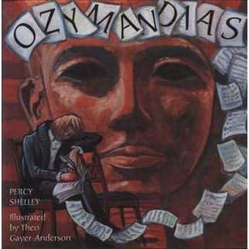
Who is ozymandias???
Ozymandias was an ancient Egyptian King, otherwise known as Rameses II of Egypt.
A powerful thirteenth-century BC Egyptian King.
Ozymandias means:
* a tyrant
* a dictator
*someone or something
of immense size
* a Colossus

Slide 7
Notes:
**sneeuh

Slide 8
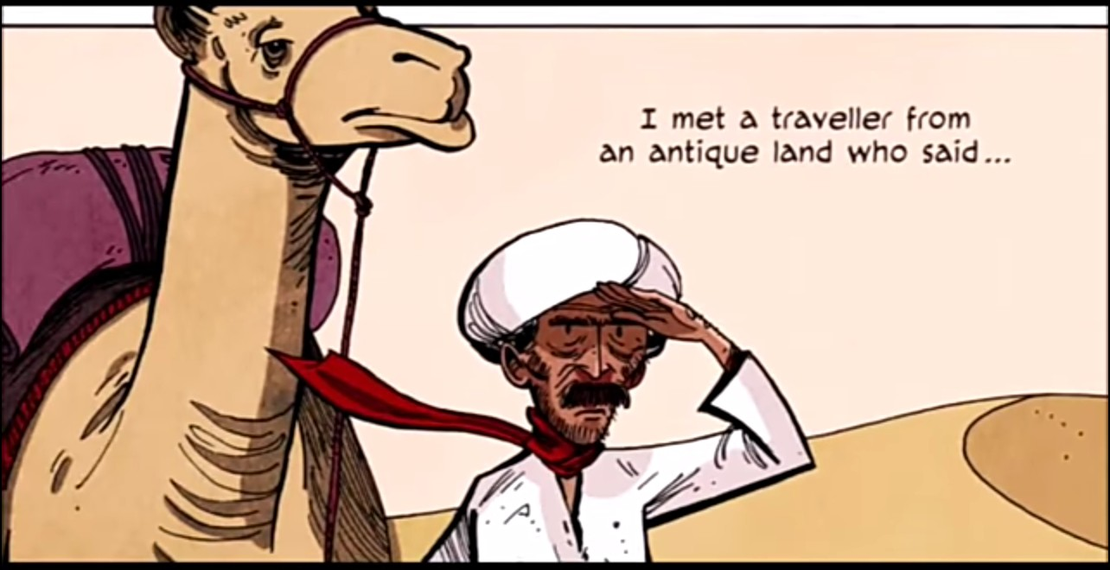
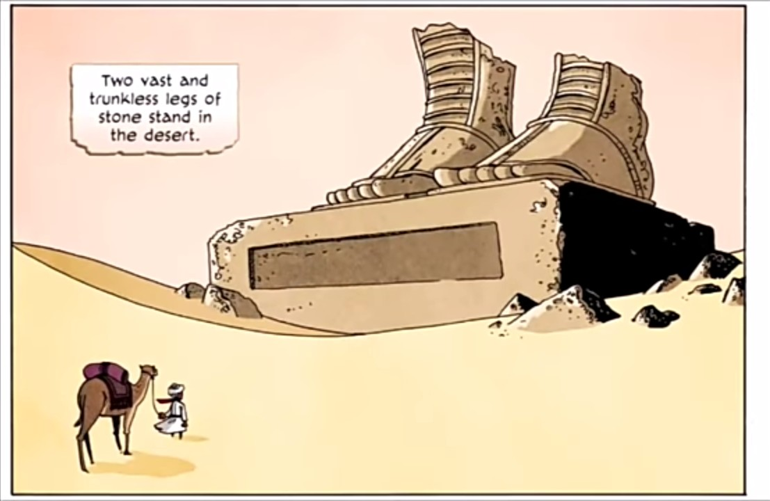

Slide 10
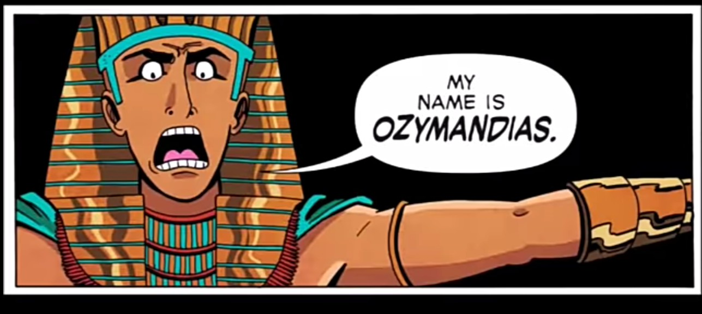
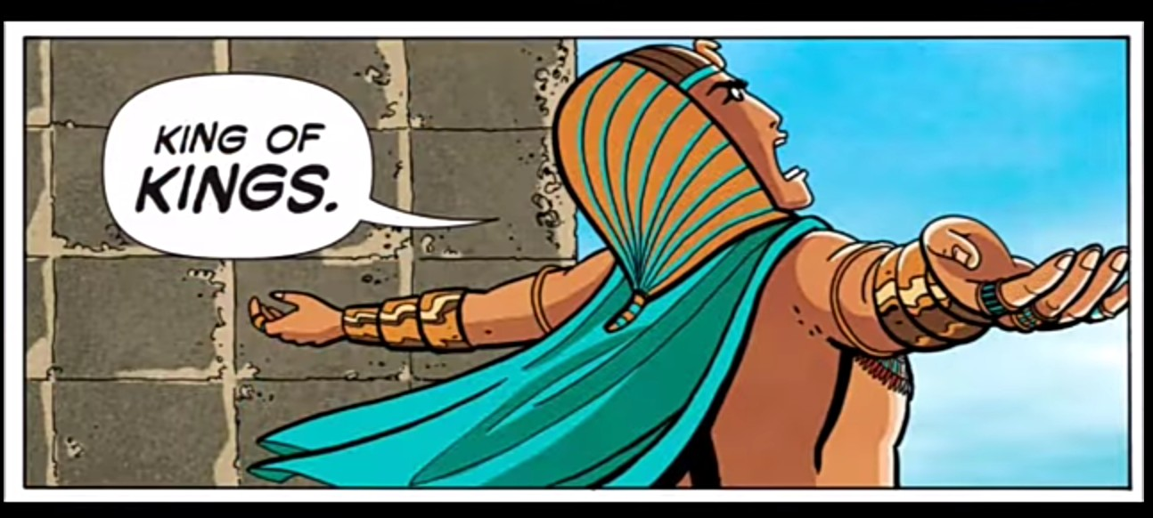

Slide 12
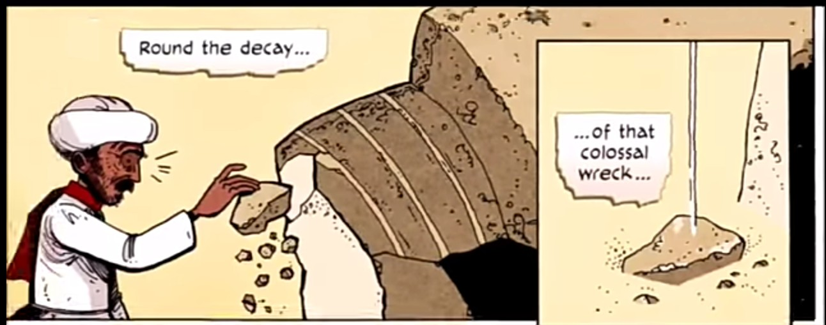

Slide 13
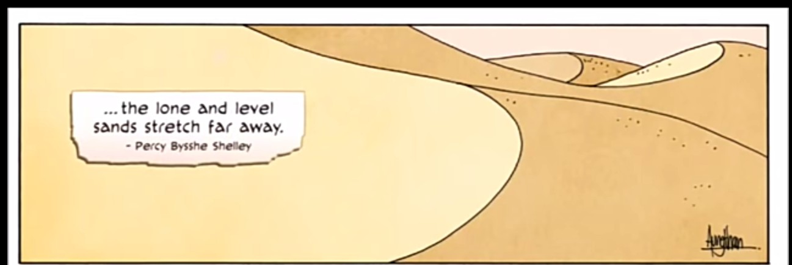

Slide 14
LITERARY DEVICES :
1) Metaphor: The statue of Ozymandias metaphorically represents power, legacy, and command.
2) Personification: Shelley has used personification that means to use human emotions for inanimate objects. He has used personification twice in the poem. The fifth line “And wrinkled lip, and sneer of cold command,” refers to the broken head of the statue. However, the lifeless statue Ozymandias is referred to as a real person. The second example is in the sixth line of the poem where “Tell that its sculptor well those passions read” shows as if the statue is commanding the sculptor how to carve or express his emotions.

Slide 15
Cont...
3) Imagery: Imagery is used to make the reader feel things through five senses. The poet has used images involving a sense of sights such as two vast and trunk-less legs, shattered face, wrinkled lip and desert. These images help readers visualize the status of the broken statue.
4) Alliteration: Alliteration is the repetition of the same consonant sounds in the same lines of the poetry such as the use of /c/ in “cold command”, the sound of /b/ in “boundless and bear” and the sound of /l/ in “lone and level.
5) Irony: Irony is a figure of speech used to present the opposite meanings of the words. Ozymandias’s description presents him as a mighty, great and fierce king but in reality, there is nothing but a broken, lifeless statue.

Slide 16
RHYME SCHEME
The rhyme scheme of the poem is
ababacdcedefef
Theme:
The Transience of Power
The Power of Art
Man Versus Nature

